Slide 1

Project Number: S16-036
Team: Julian Esteban, Kanav Tahilramani, Matthew Chatten, Sujay Bandarpalle
Advisor: Dr. Shantenu Jha

Slide 2
Original Proposal and Outlined Tasks
Build a social media analysis tool specifically for the public user profiles of Reddit users and various Reddit communities (“subreddits”)
Project Tasks:
Complete - Figure out the software stack that best supports the project
Complete - Implement solid program architecture for handling API requests, script-based NLP, database storage of results, and presentation of final analysis
In Progress - Decide on and code useful analytical functions
Complete - Build architecture to point that features can be added individually
In Progress - Implement full suite of features
In Progress - Testing, validation, respond to feedback
In Progress - Produce reports/presentations/poster as required

Slide 3
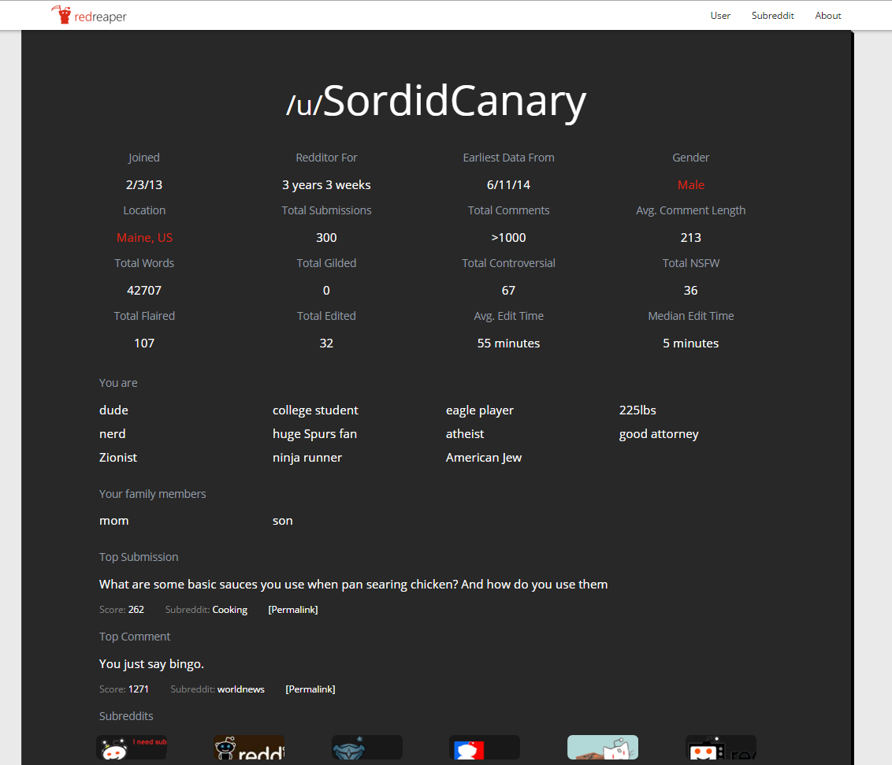
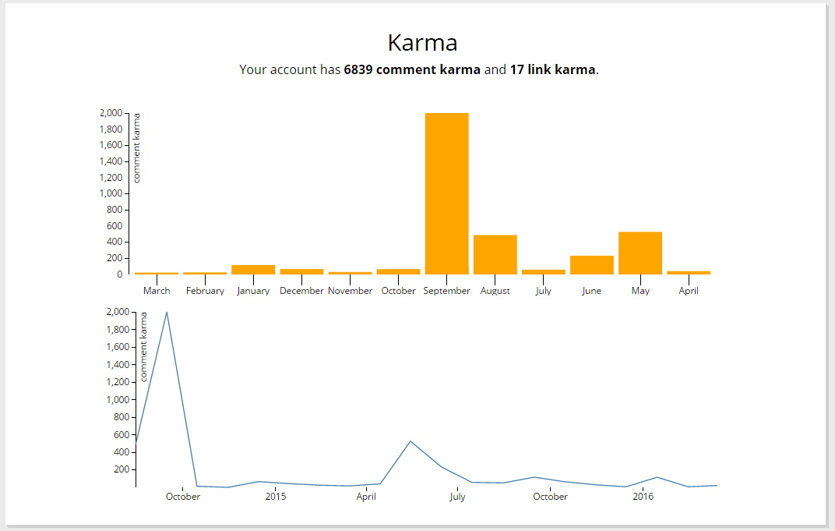
Implementation

Slide 4
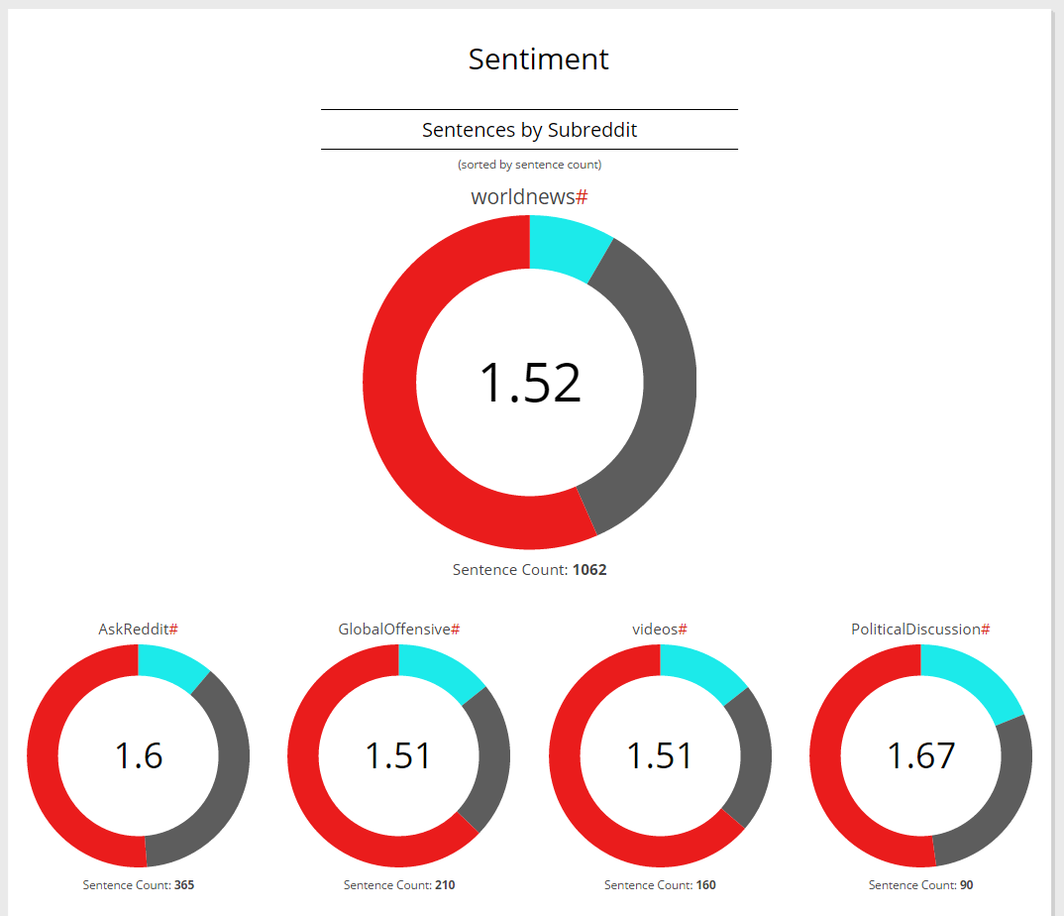
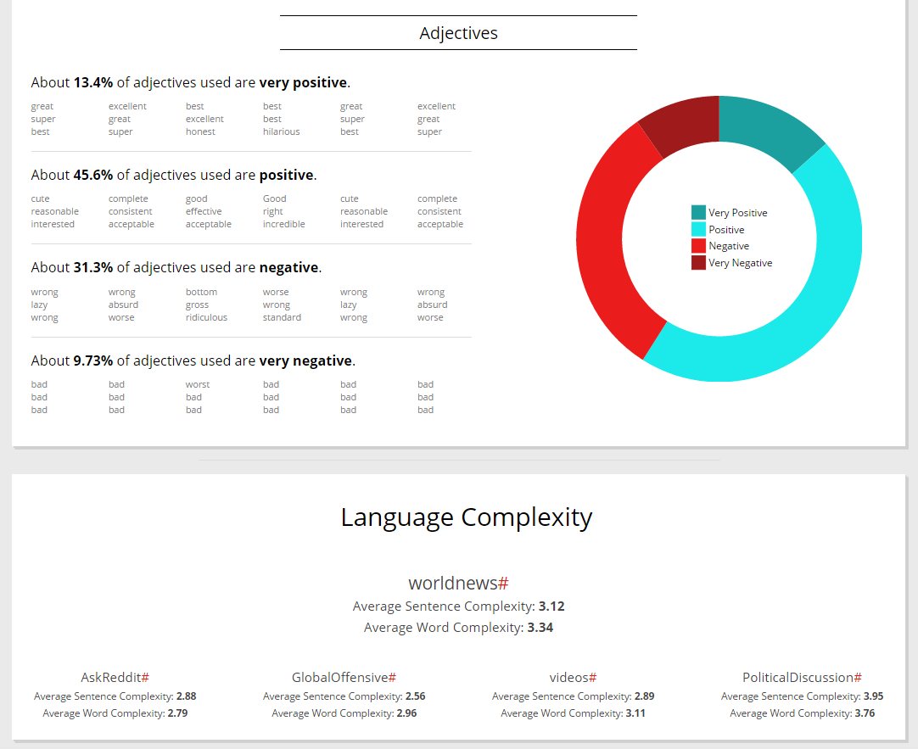
Implementation

Slide 5
Performance
Database Operation
Load and store times nominal
Analysis Time
On higher end of expectations
Implemented a loading gif
Website performance
Page load times fast
Interactive portions are responsive

Slide 6
Challenges So Far
Integrating software stack
Making sure NLP tools work
Making sure implementation is robust across different systems
Performance
Reducing time taken by NLP analysis
Limiting database storage
General Debugging
Surprisingly tricky glitch that caused analysis to run twice
Dealing with edge cases in NLP or API responses
Code cleanliness
Keeping functions separate and organized with multiple people

Slide 7
Looking Forward
Short Term
Implementing more analysis
Organizing output
Medium Term
Test and improve performance
General testing and error-checking
Begin draft of final report
Long Term
Finalization of design
Create poster, plan final presentation, etc.
Possibly set up public deployment

